Slide 1
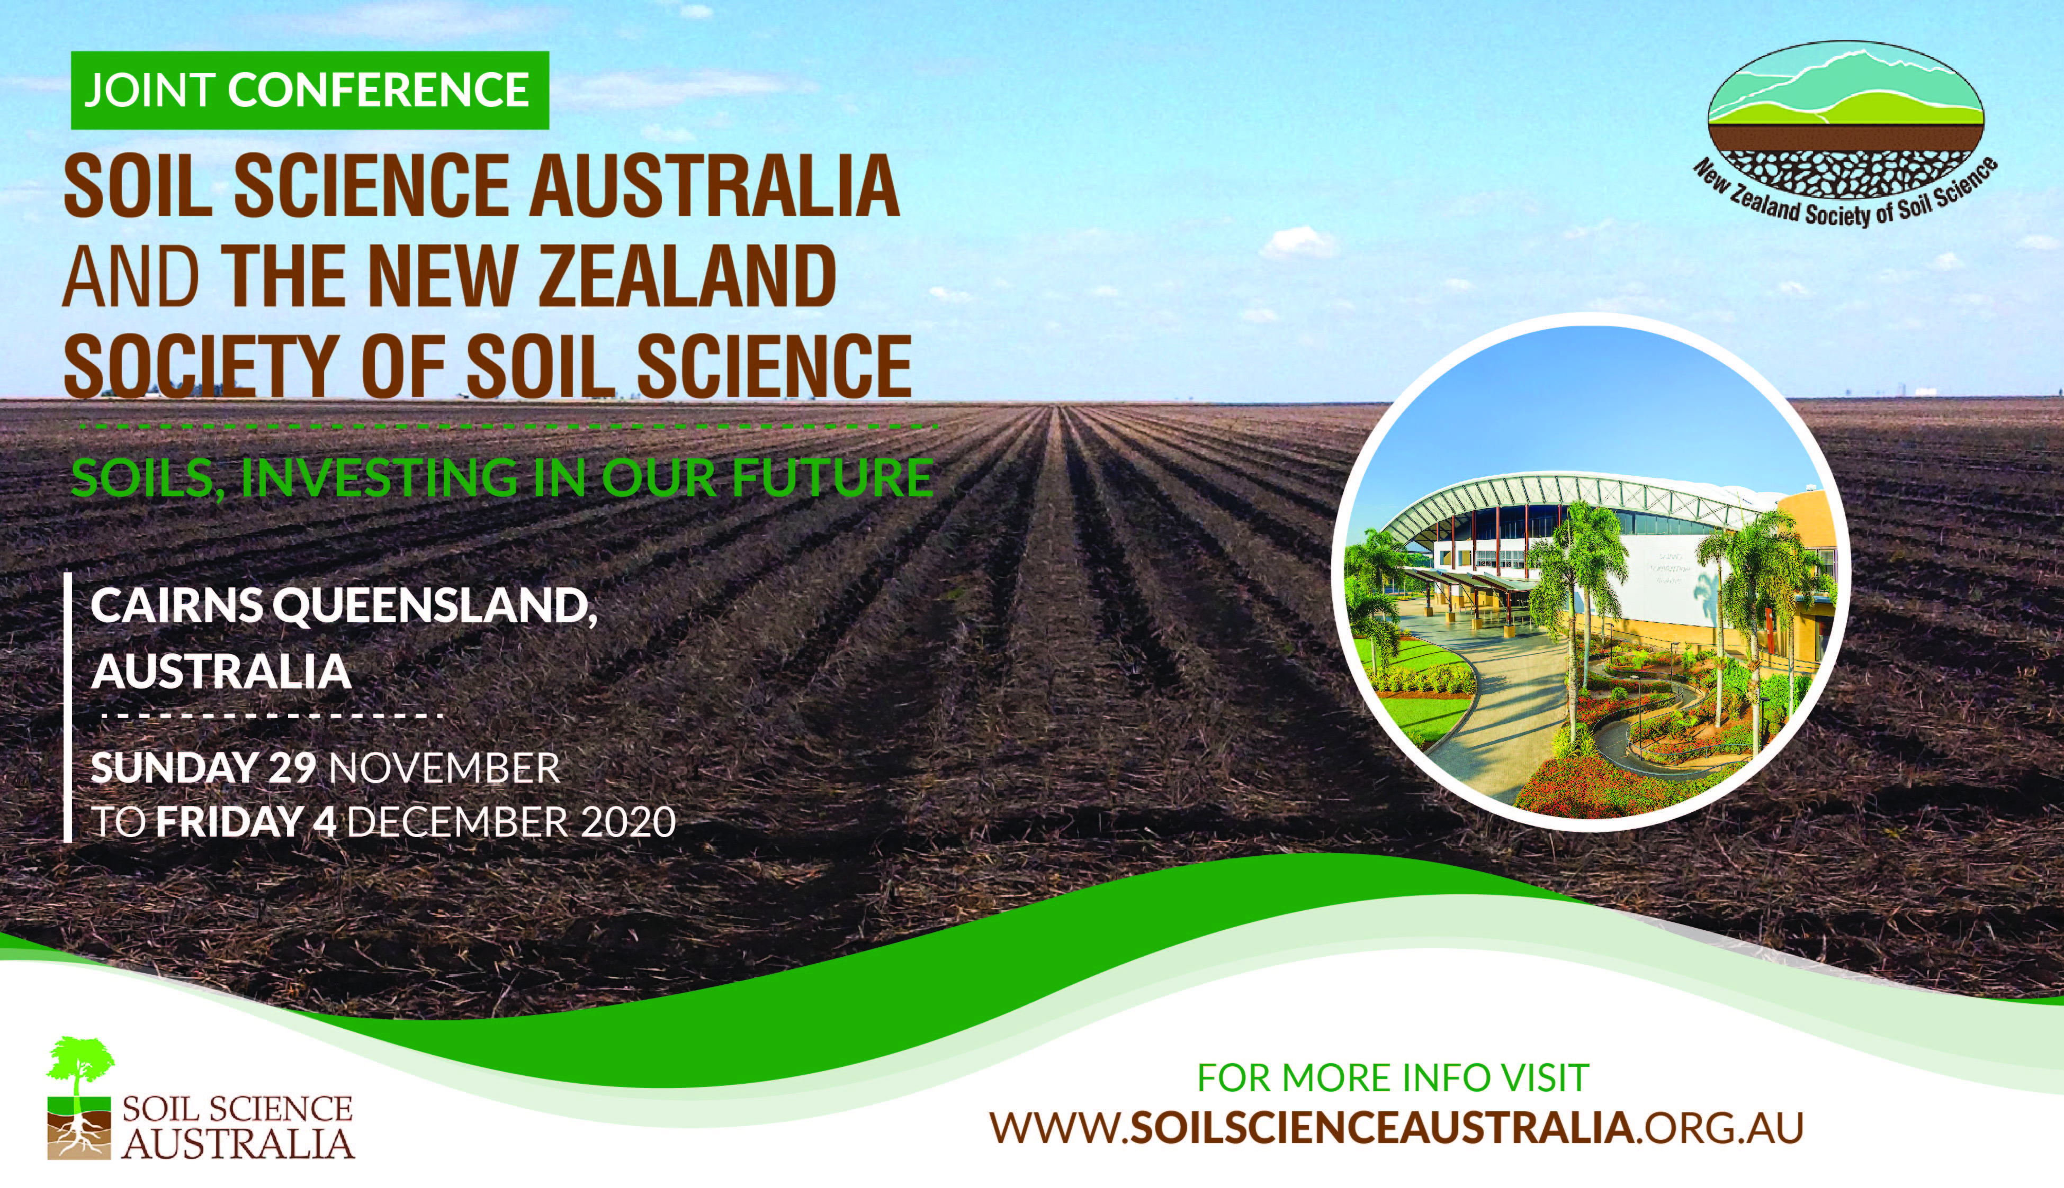

Slide 2
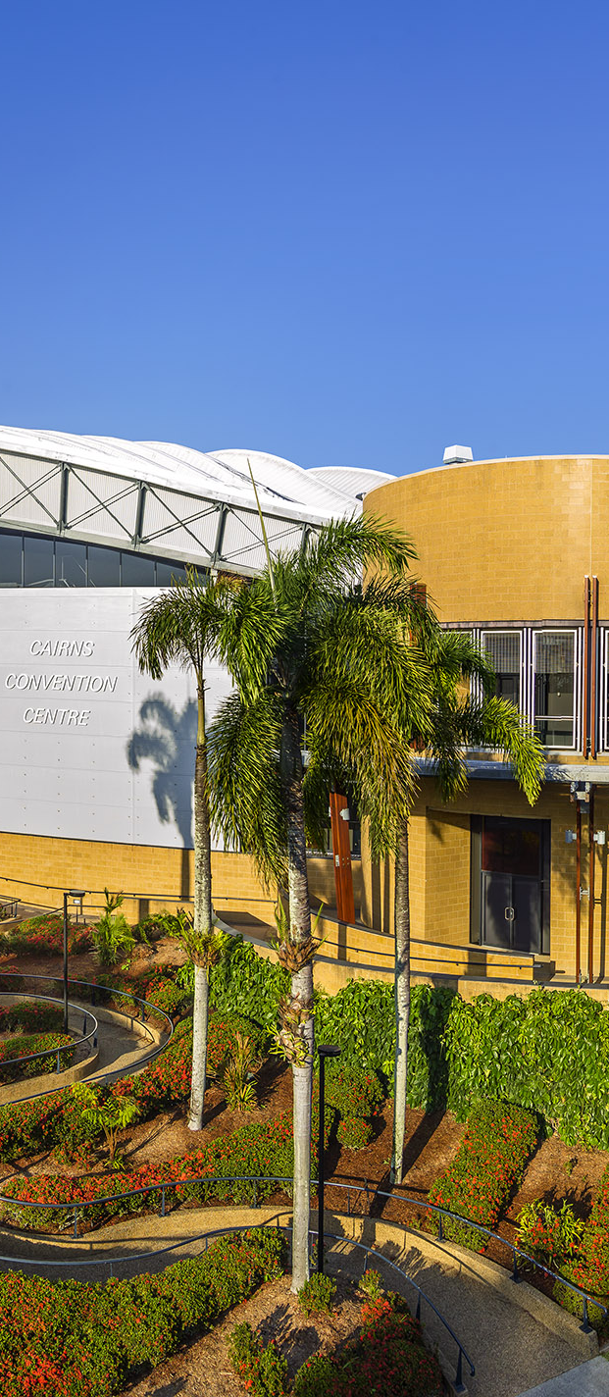
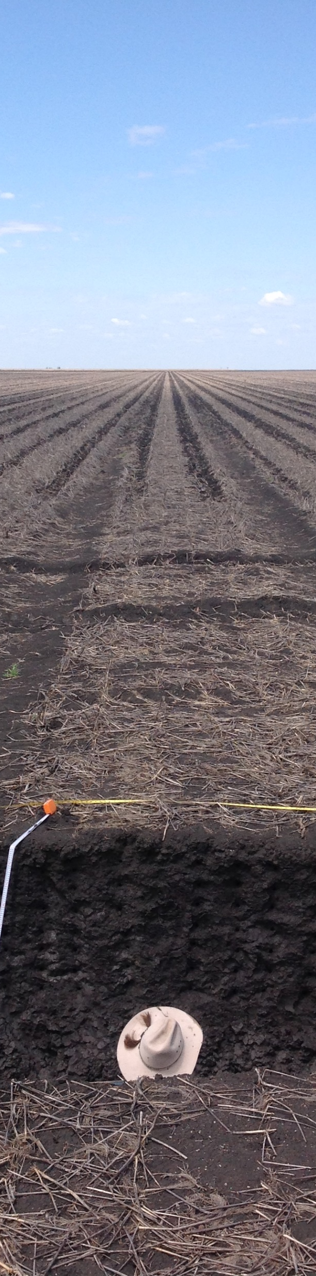
THEMES
Soils and climate change
Soil structural and hydrological systems and their management in the environment
The role of soils in future function of farming and catchment systems
Advances in soil science for improved decision making
Pedology, soil landscapes and spatial mapping: informing the future
Advances in macro/micro biology and lessons for improved soil function
Protecting our soil resource from degradation & contamination
Effective management of nutrients and water

Slide 3
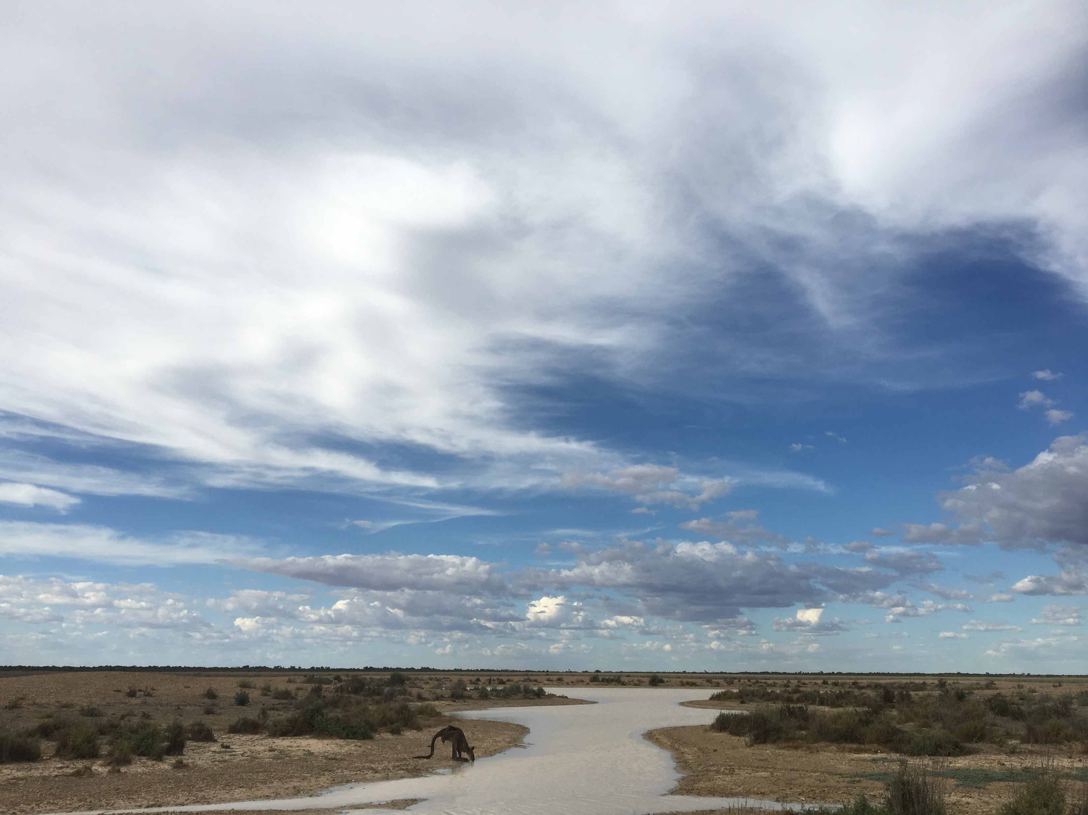
KEY DATES
06
DEC
Call for Special Sessions Open
14
FEB
Special Sessions
Close
01
MAR
Call for Abstracts
Open
01
MAR
Earlybird Registrations
Open

